Slide 1
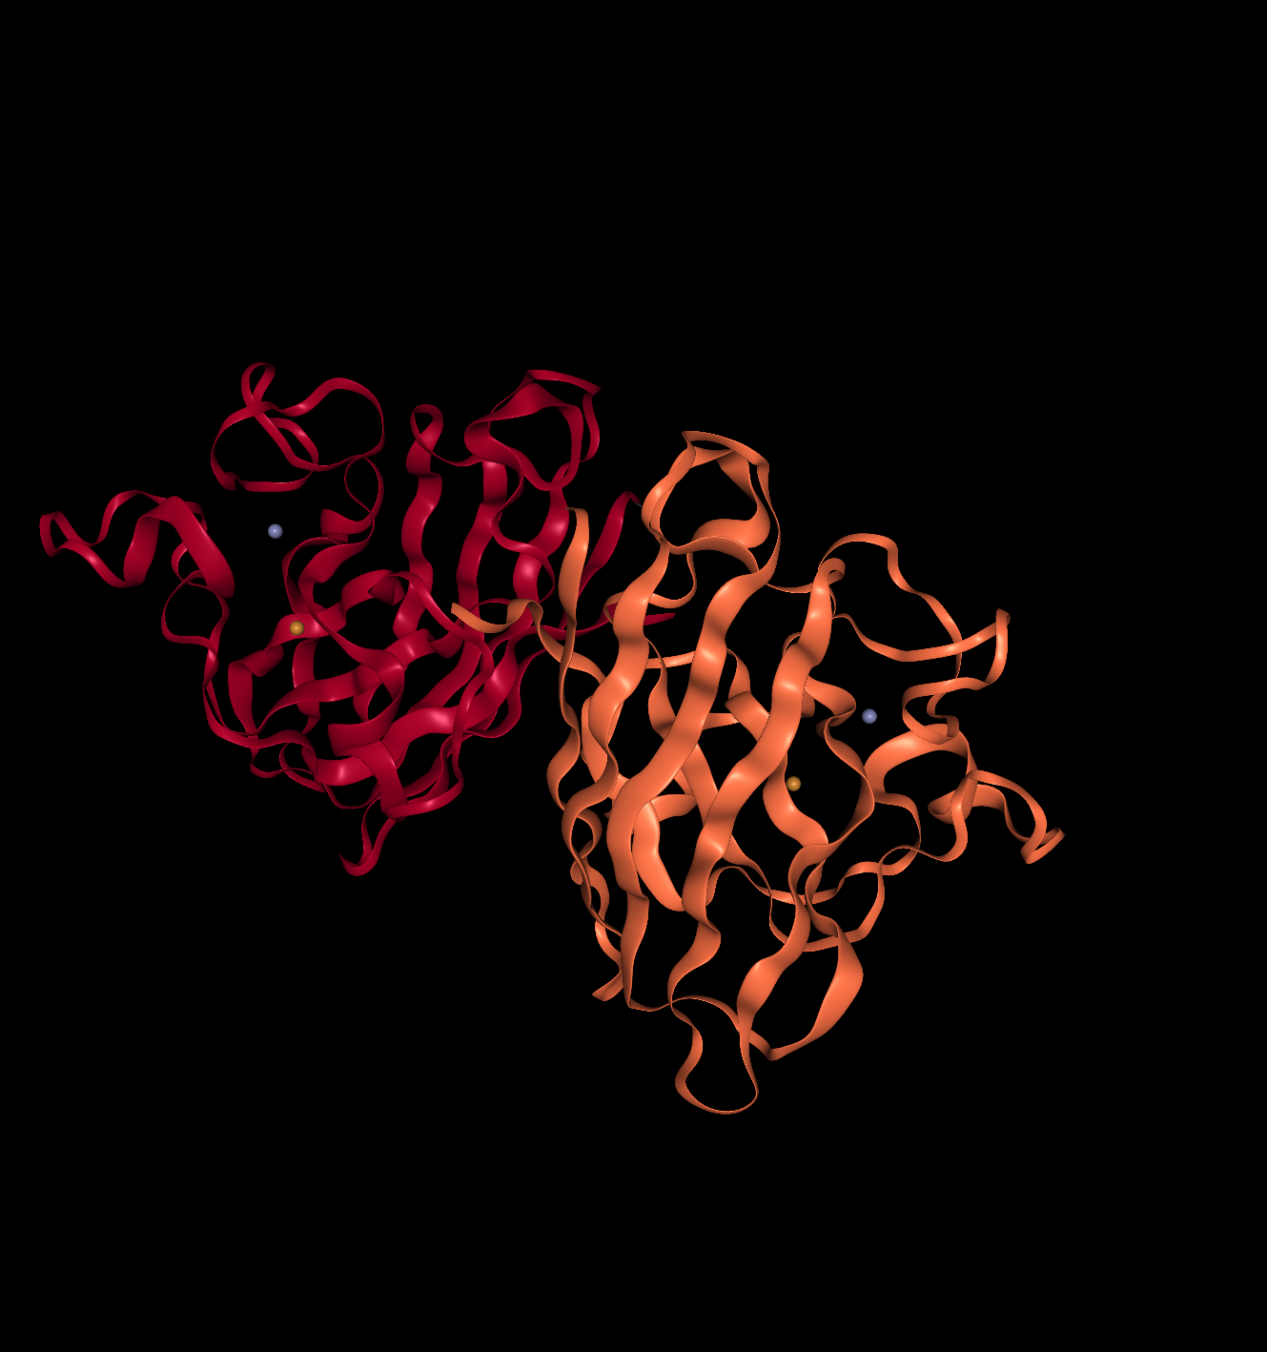

Superoxide dismutase [Cu-Zn]
HSod dimer, visualised by chain on PDB, ID: 3KH4

Slide 2
Superoxide dismutase SOD1
Protein family with 3 different isoforms
SOD1 in Cytoplasm
Metal binding domain
Cu & Zn²⁺
Catalytic activity
2 H+ + 2 O₂^{•-} O₂ + H₂O₂

Slide 3
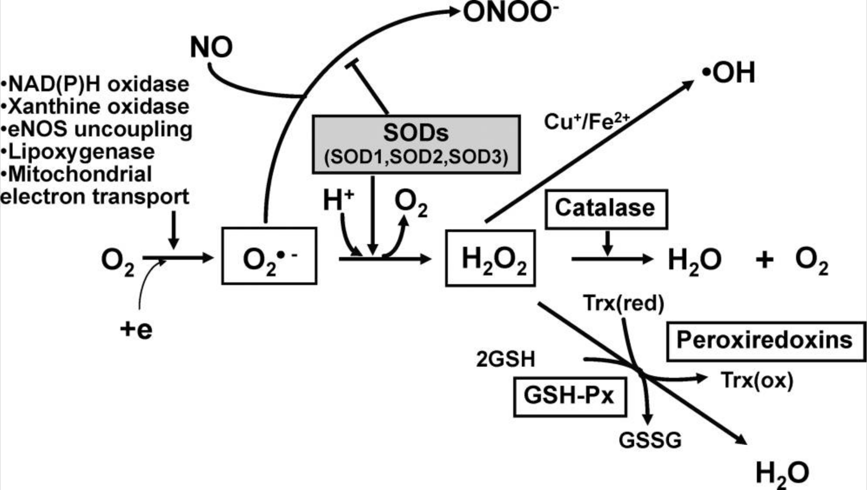
SOD and its biological function
Important enzyme in ROS clearing
Involved in cell signaling
Fukai T, Ushio-Fukai M. Superoxide dismutases: role in redox signaling, vascular function, and diseases. Antioxid Redox Signal. 2011;15(6):1583–1606. doi:10.1089/ars.2011.3999

Slide 4
Impact of SOD1
SOD1 is essential for the survival of aerobic organisms
Balance between ROS production and clearing capacity
Mondola P, Damiano S, Sasso A, Santillo M. The Cu, Zn Superoxide Dismutase: Not Only a Dismutase Enzyme. Front Physiol. 2016;7:594. Published 2016 Nov 29. doi:10.3389/fphys.2016.00594

Slide 5

Amyotrophic Lateral Sclerosis

Slide 6
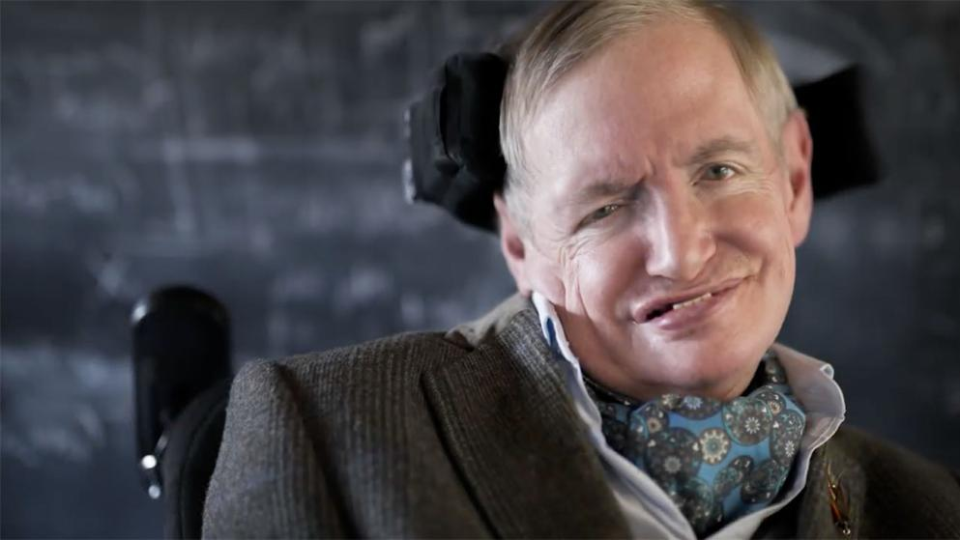
Amyotrophic Lateral Sclerosis...
… is a progressive adult onset disease
… results in upper and lower motor neuron degeneration
… leads to muscle weakness and paralysis
Patients usually die 1-5 years after onset.
Image: Bild.de

Slide 7
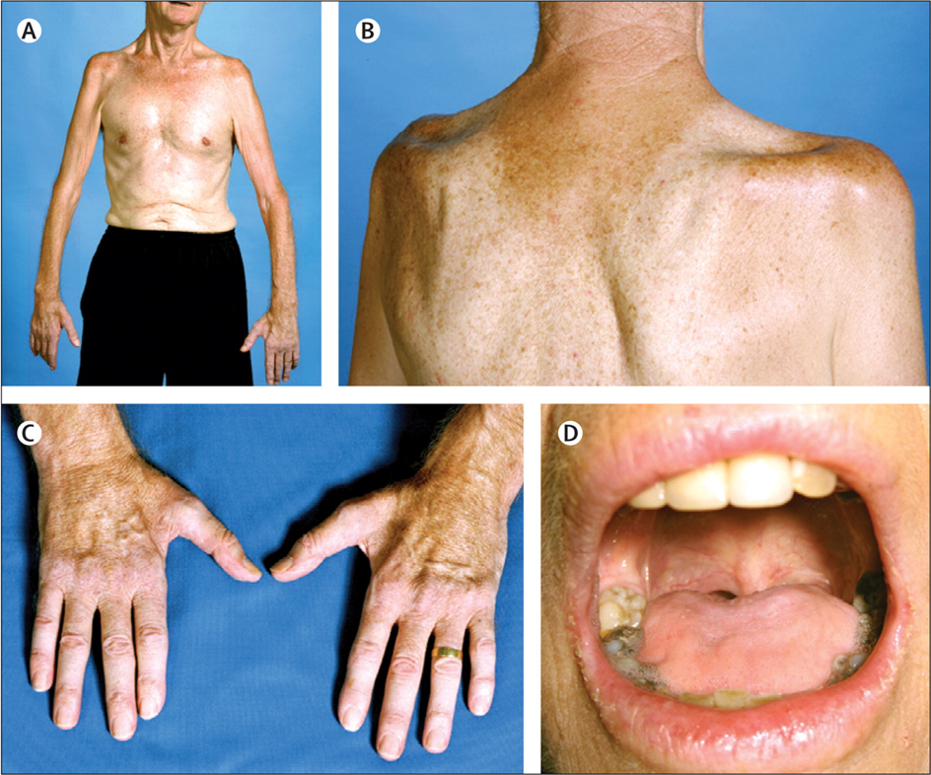
Amyotrophic Lateral Sclerosis
Roughly 1 in 100'000 each year
Relatively rare, but high economic and social burden
Worst quality of life in all neurological patients. Experience disease fully!
Muscle wasting and twitching, speech difficulties
Lancet 2011

Slide 8
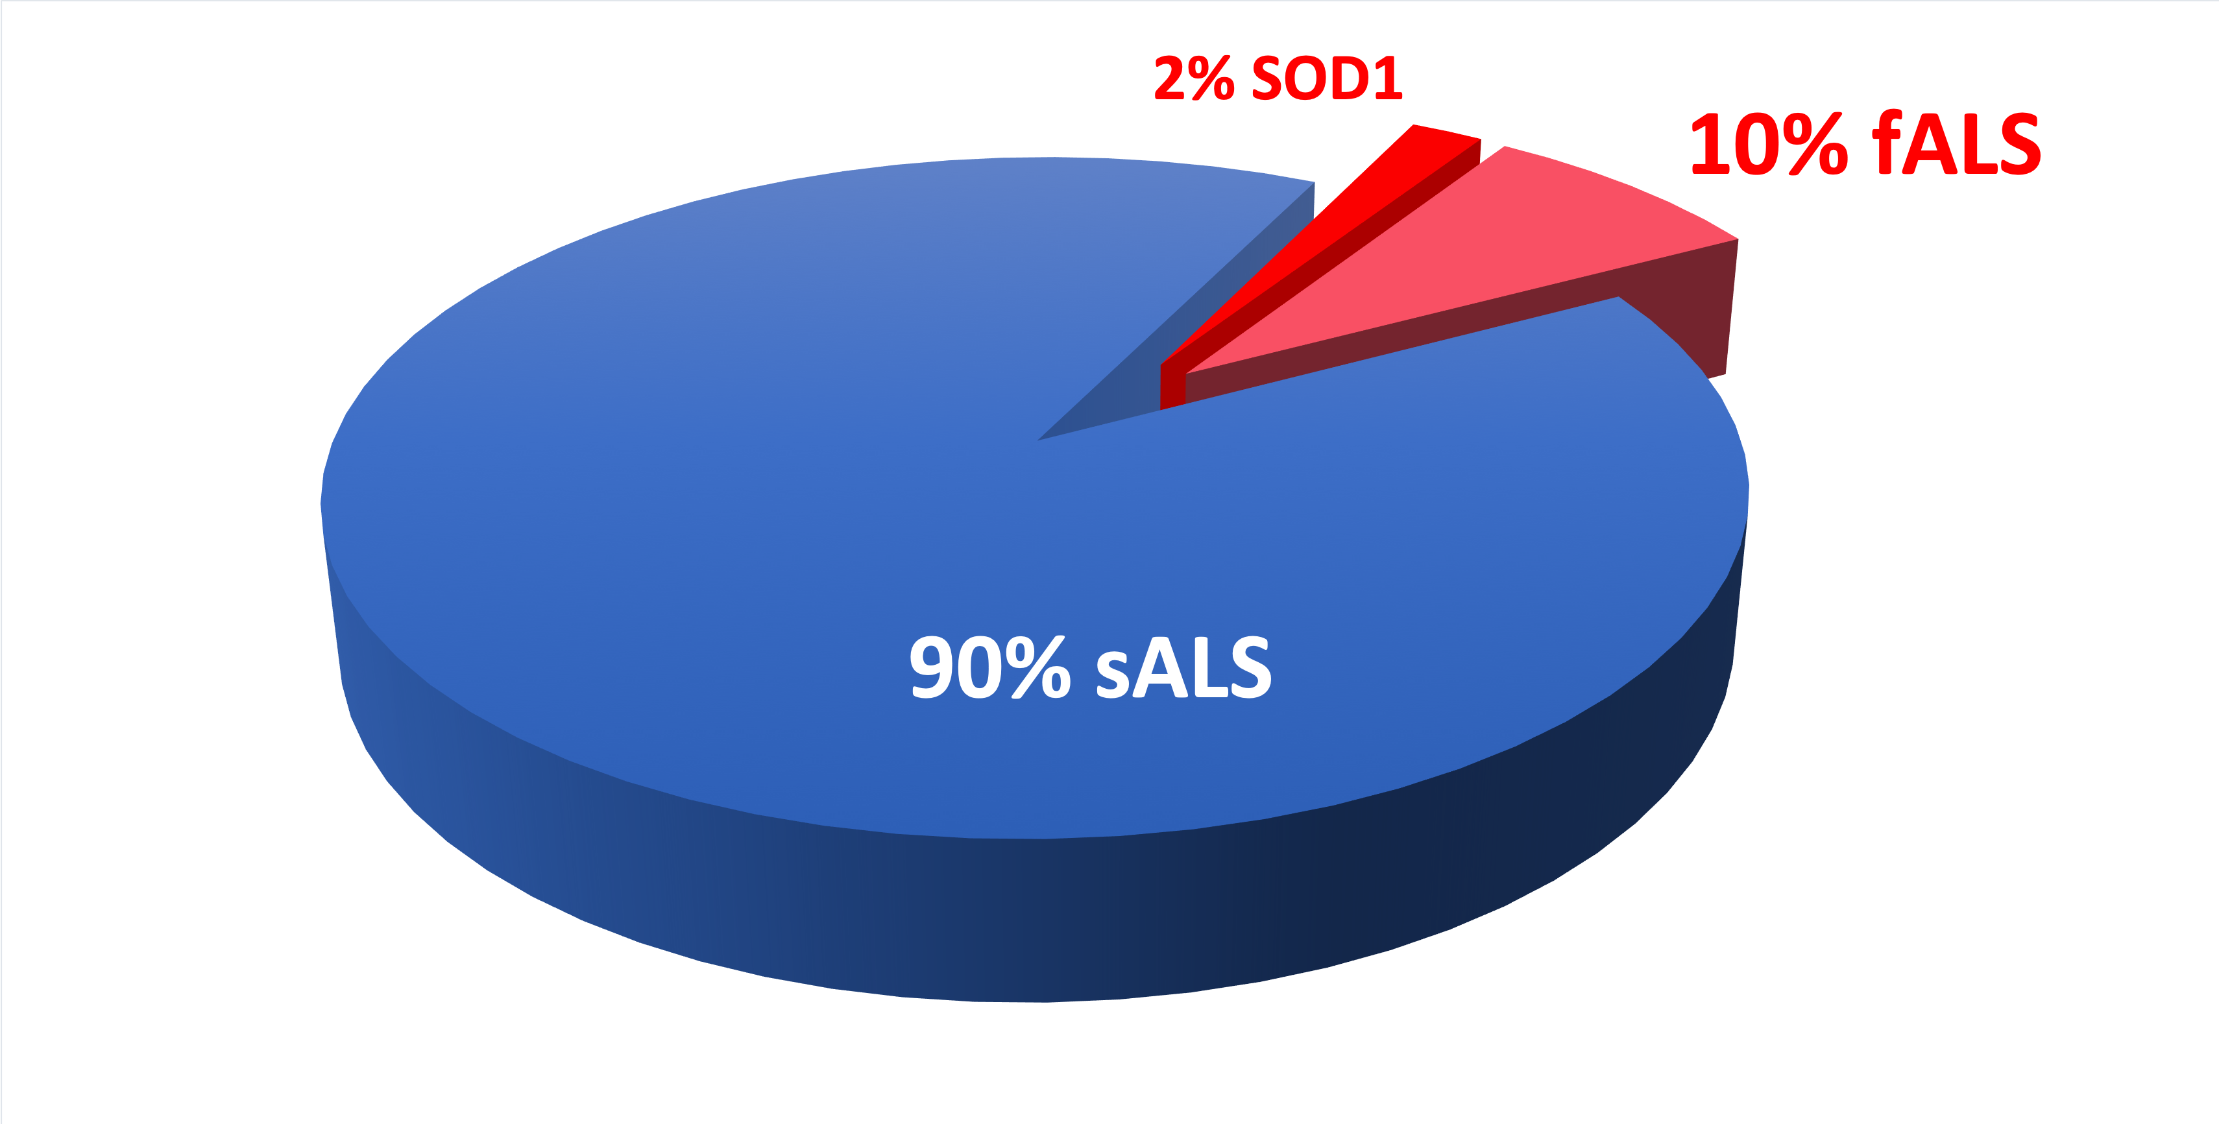
Amyotrophic Lateral Sclerosis
Mostly sporadic no inheritance
10% of ALS cases inherited
Of those, roughly 20% are associated with SOD1

Slide 9
SOD1 and ALS

Slide 10
SOD1 and ALS
More than 170 different SOD1 mutations cause ALS
Formation of dimer necessary for function
Mutations destabilize the dimer and cause misfold or loss of function

Slide 11
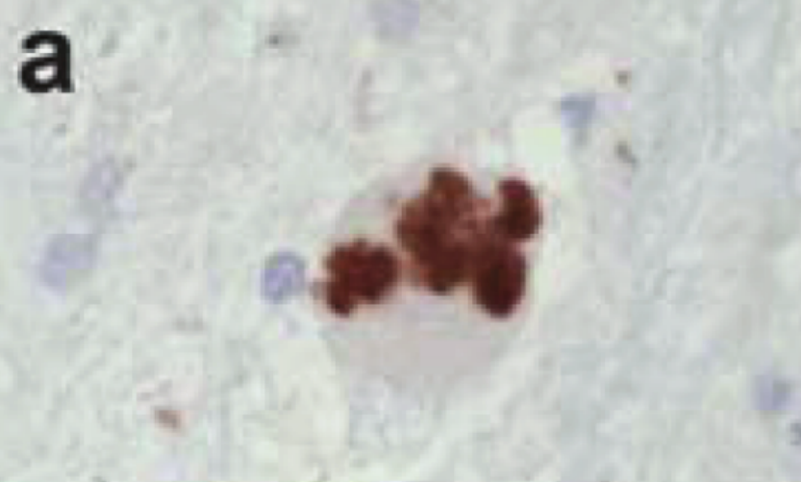
SOD1 and ALS
Loss of function not causative for ALS
Accumulation of misfolded SOD1 become toxic
Ubiquitin inclusions contain SOD1 in fALS cases with SOD1 mutations. Kerman et al., Acta Neuropa., 2010

Slide 12
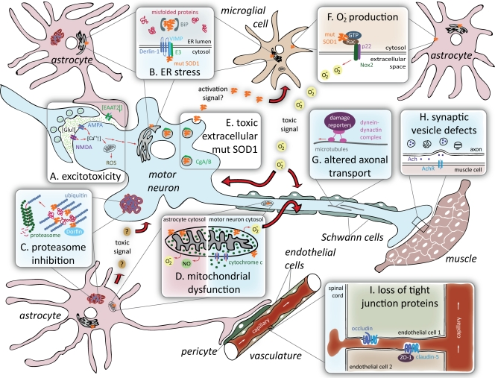
SOD1 and ALS
Proposed mechanisms of toxicity in SOD1-mediated ALS
Ilieva H, Polymenidou M, Cleveland DW, JBC, 2009

Slide 13
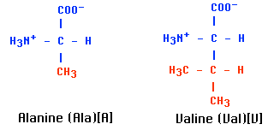
dbSNP:rs121912442
Organism: Homo sapiens
Position: chr21:31659783 (GRCh38.p12)
Alleles: C>T
Variation Type: SNV Single Nucleotide Variation
A [GCC] > V [GTC]
A (Ala) > V (Val) Missense Variant

